Slide 1

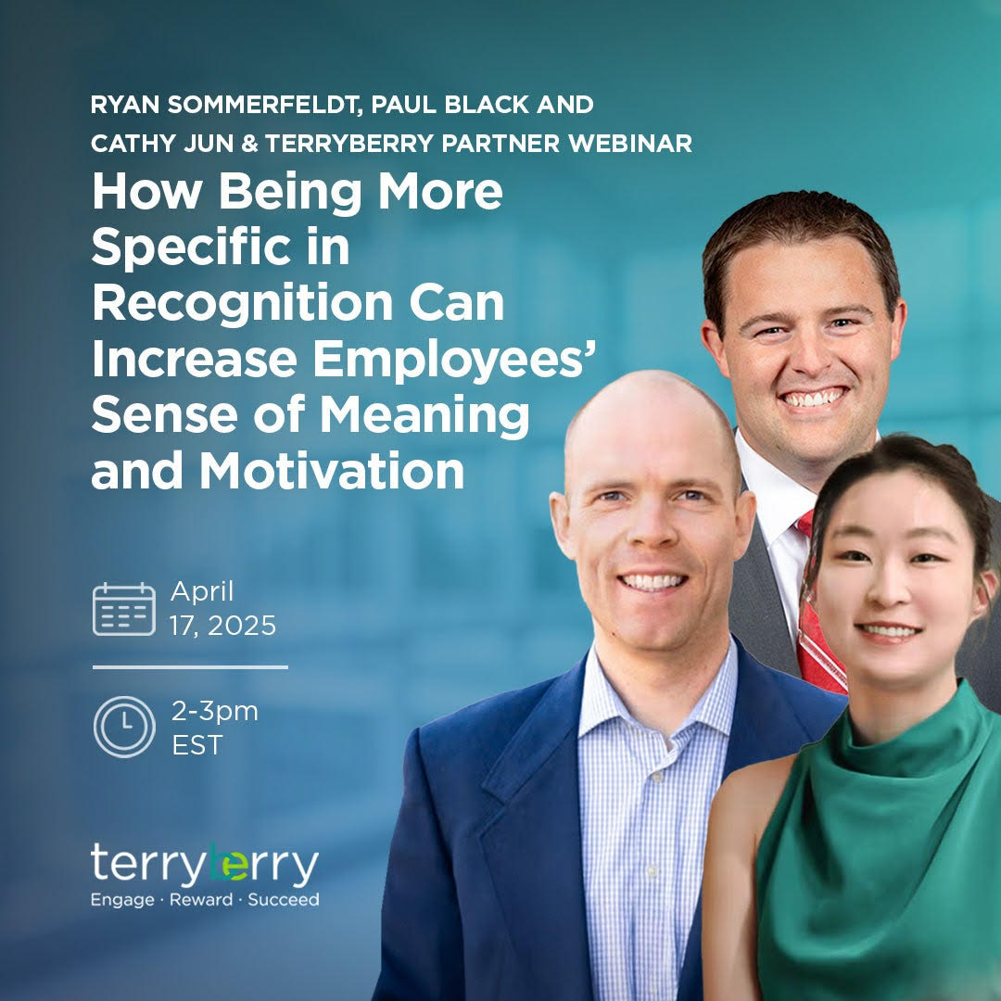




Title

Slide 2
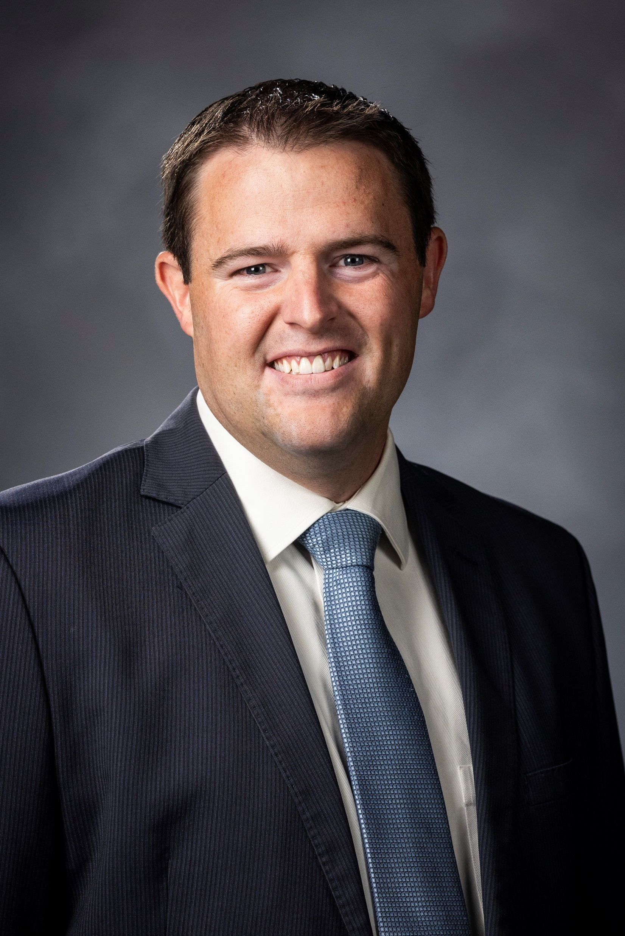
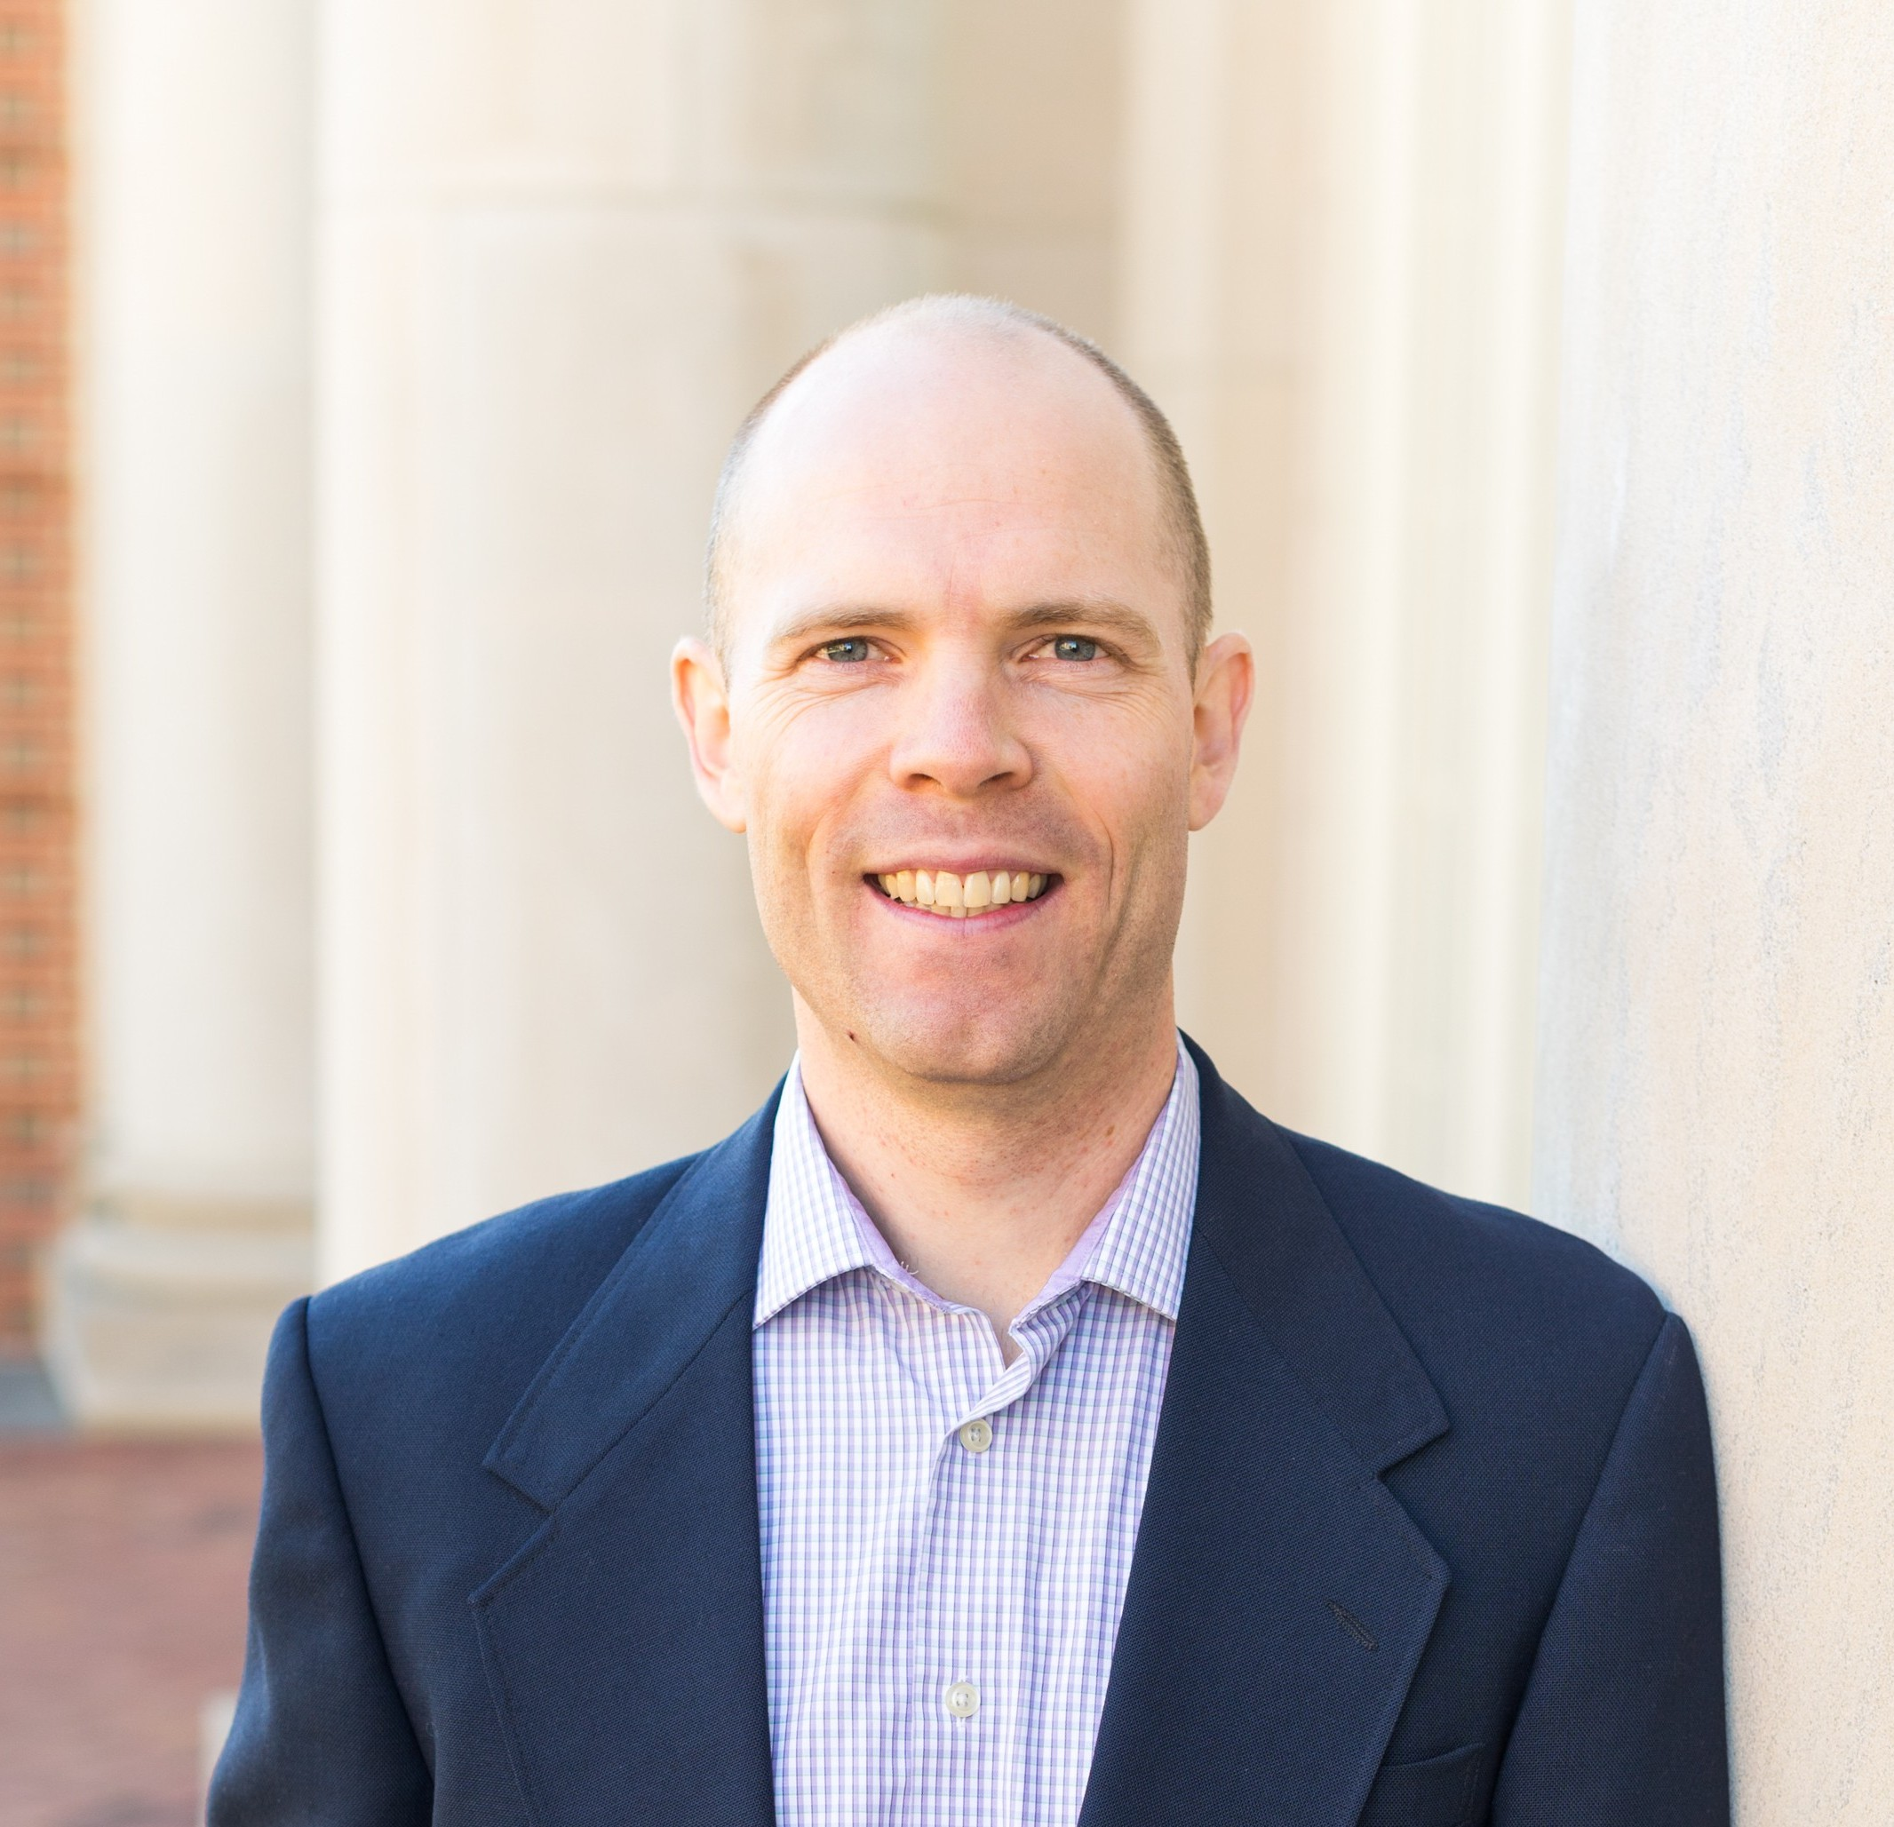
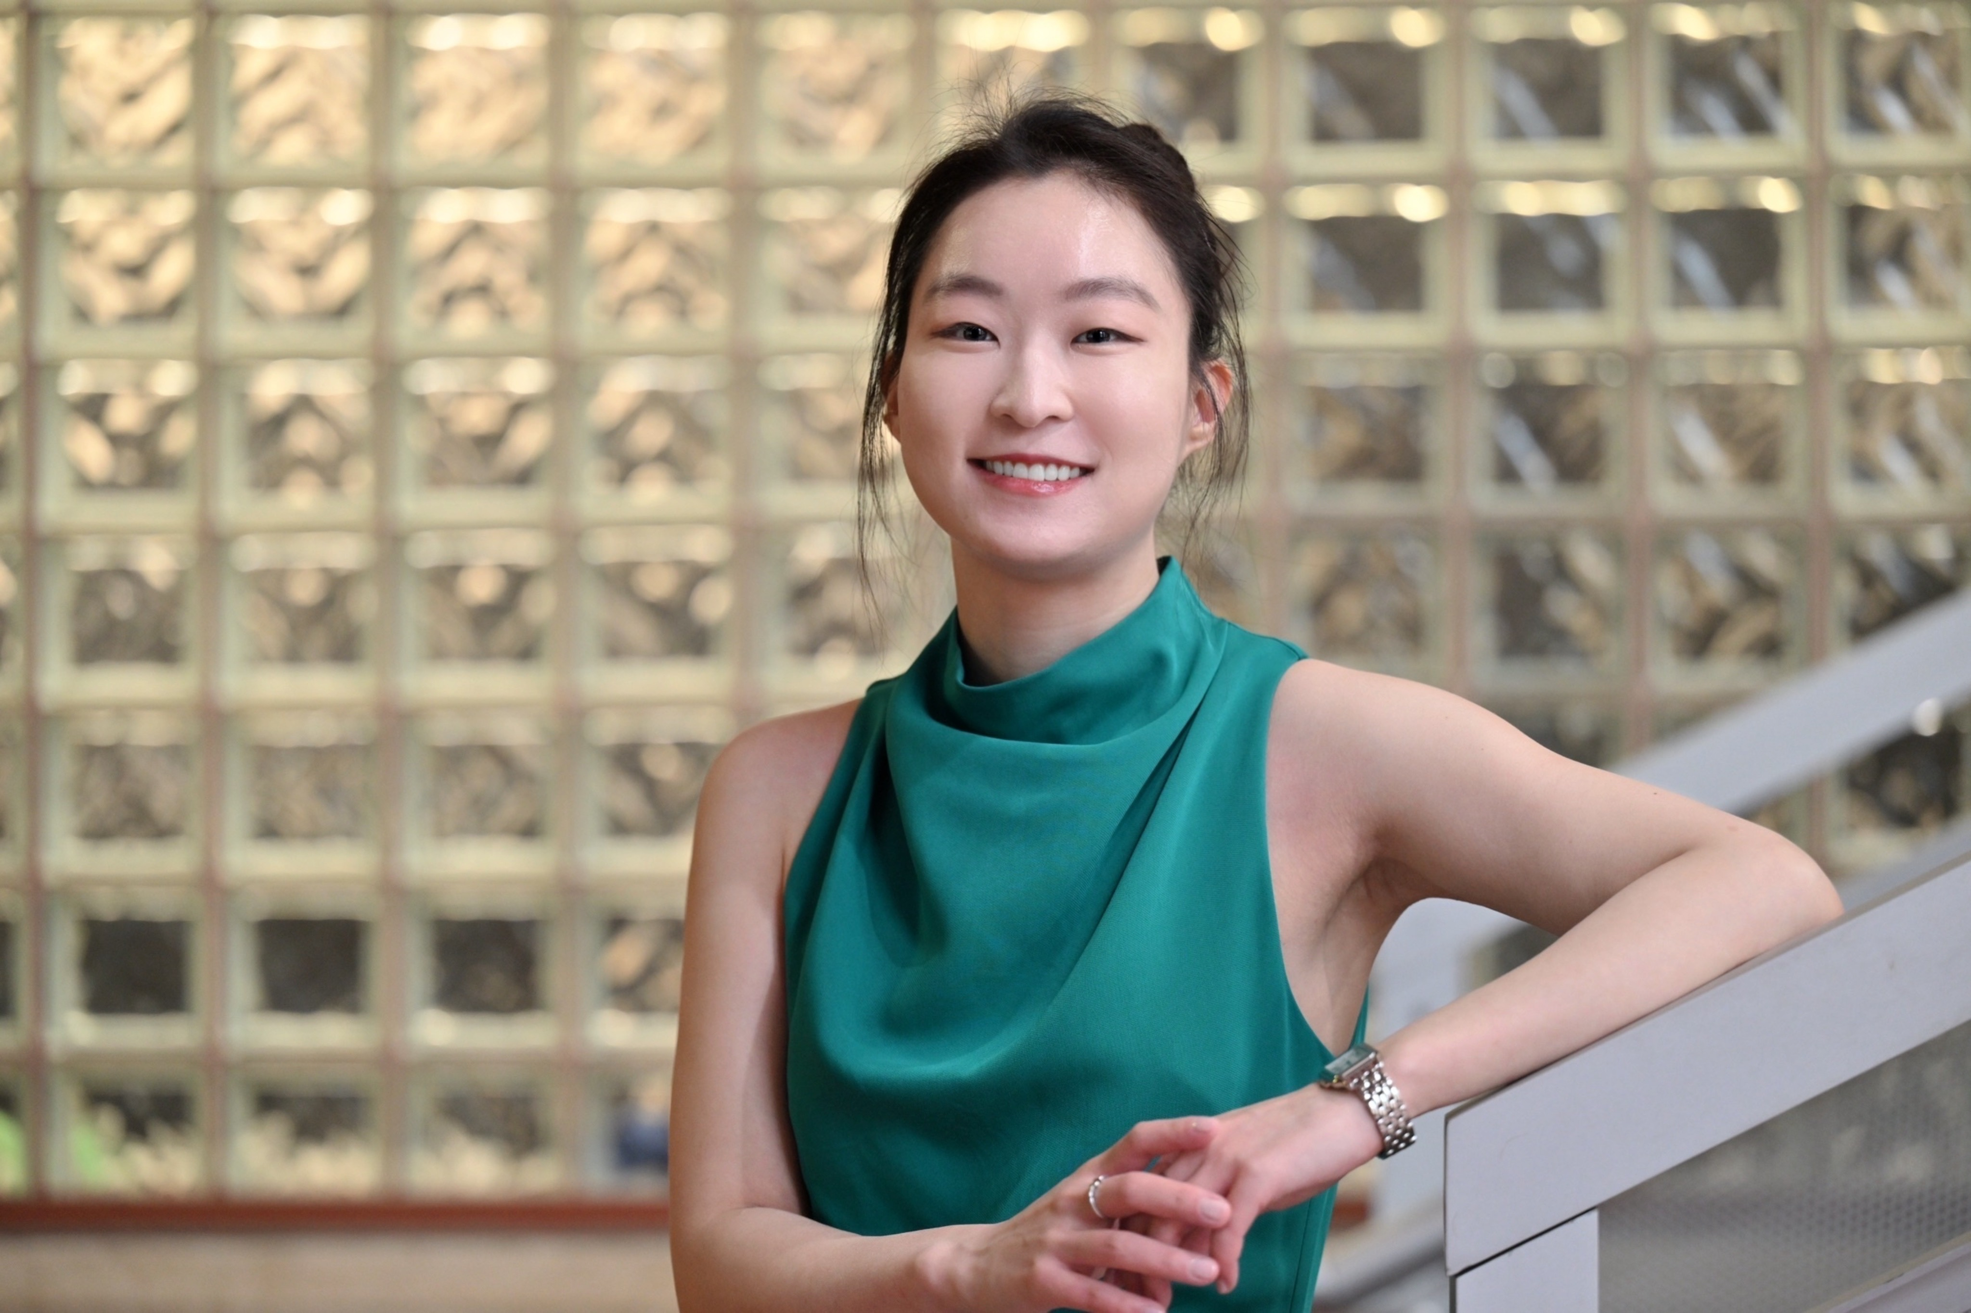
Introductions
Paul Black
Accounting Professor
Auburn University
Cathy Jun
Accounting PhD Candidate
Washington State University
Ryan Sommerfeldt
Accounting Professor
Brigham Young University

Slide 3
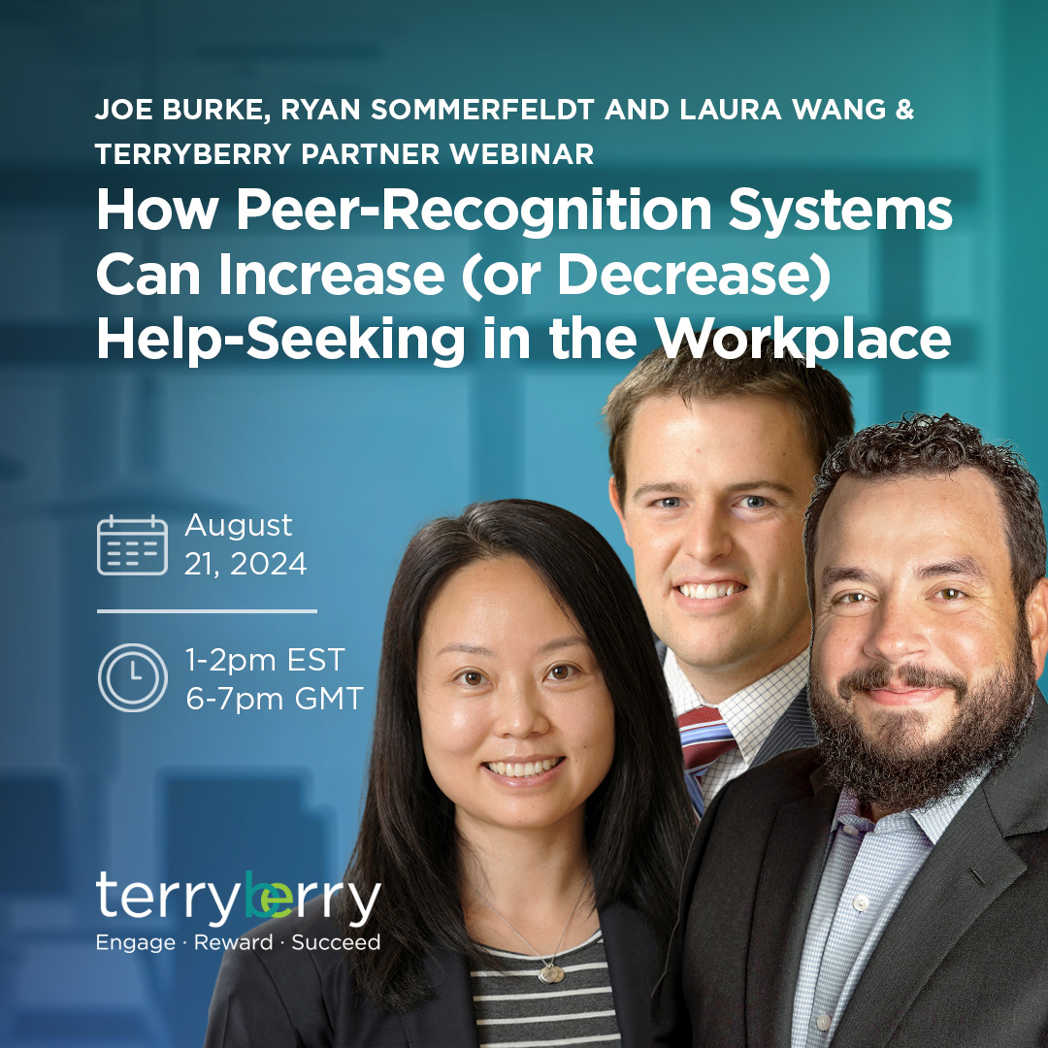
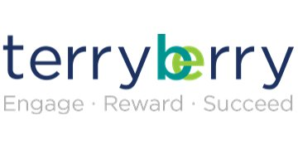
Connection to Terryberry
Do Words Matter? The Effect of Recognition Narrative Specificity and Prosocial Motivation on Work Effort

Slide 4


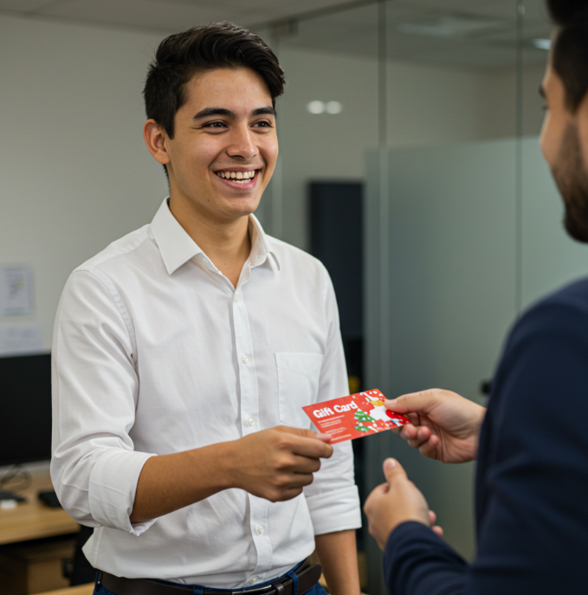
Recognition

Slide 5








Recognition Systems
96 billion + spent on employee rewards and recognition
Clients:
Also lots of providers

Slide 6
For:
Outstanding performance
Living core values
Helping others
Customer service
Tenure with the company
Etc.
From:
Managers
Peers
Subordinates
Etc.
Recognition
Given Through:
Recognition software
Email
Departmental meetings
Handwritten notes
Etc.
Include:
Recognition messages
Cash/gift cards
Donations to charity
Symbolic awards
Benefits
Etc.

Slide 7
Poll Question
How much time would you estimate you spend composing a recognition (including thank you) message to someone at work?
  1 minute or less
  1-5 minutes
  5-10 minutes
  10-15 minutes
  Over 15 minutes
  I’ve never written a recognition message

Slide 8
Specificity
Generic recognition
  “Riley, thank you for your help!”
Specific recognition
  “Riley, thank you for your help! Your leadership on the customer engagement initiative was impressive. I especially appreciated your recommendation to use our customer database to provide personalized customer service. I plan to take your recommendations to my manager meeting next week. Thank you again for your hard work!”

Slide 9



Prosocial Motivation
Prosocial Motivation: The "desire to benefit others."
Specific narrative recognition

Slide 10
Poll Question
Rank order: Rank the following in the order of what you believe matters most to your employees – from 1 (most important) to 4 (least important).
Flexibility in their work
Financial rewards
Feeling cared for by co-workers
Finding meaning in their job

Slide 11
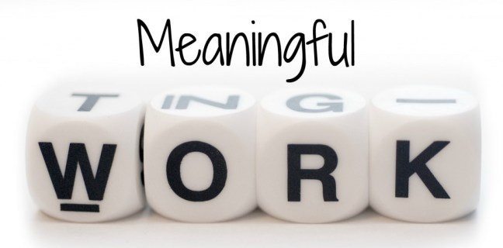
Meaning
69% of employees view finding meaning and fulfillment at work as one of the most important employment factors
  Sethi, Brown, Stubbings, and Mukherjee 2022
McKinsey & Company survey: Employee performance increased by 33% when employees find meaning
Only 50% of employees report finding meaning at work
  Bromley, Lauricella, and Schaninger 2021

Slide 12
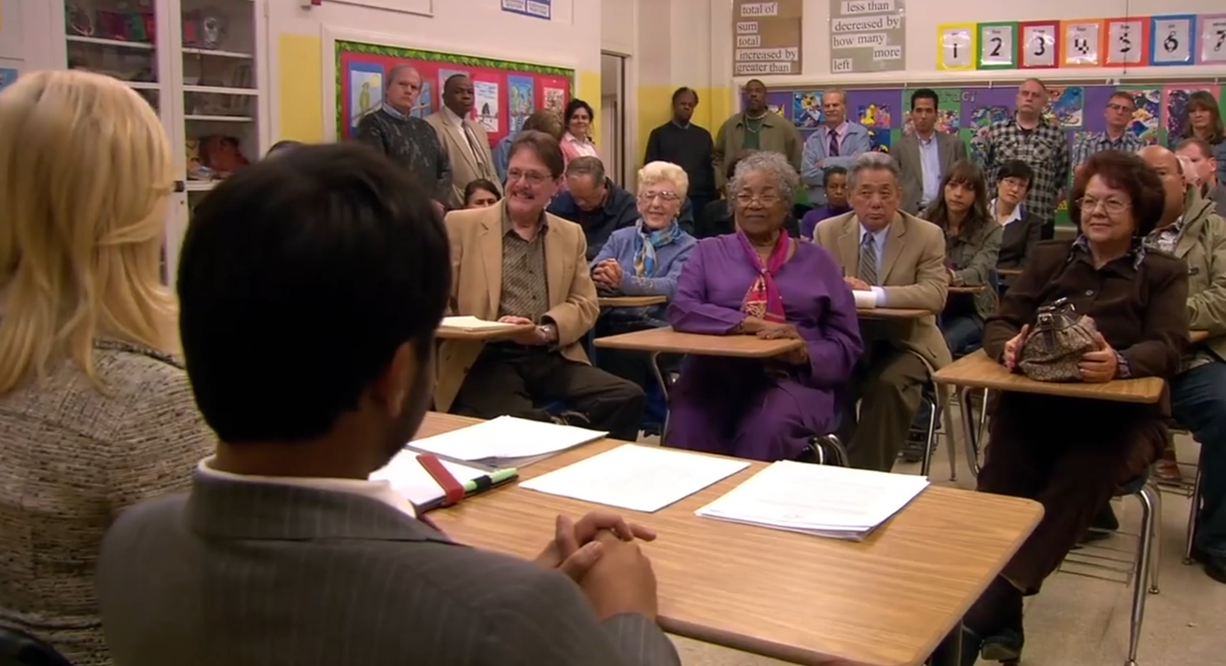
Job Crafting
“What I hear when I’m being yelled at is people caring loudly at me.”

Slide 13

Job Crafting
Cognitive Job Crafting: Employees change the way they perceive their job.
Employees are more easily able
to cognitively craft their job when
they receive specific recognition.
Dutton, J. E., Debebe, G., and Wrzesniewski (2016)

Slide 14

Main Experiment
Three-part framed field experiment.
  Recruited 185 business students.
Participants are asked to help the research team in creating a campus tour for the university.

Slide 15

Main Experiment
What are the different versions of the experiment?
  Version 1: Generic narrative recognition
  Version 2: Specific narrative recognition

Slide 16
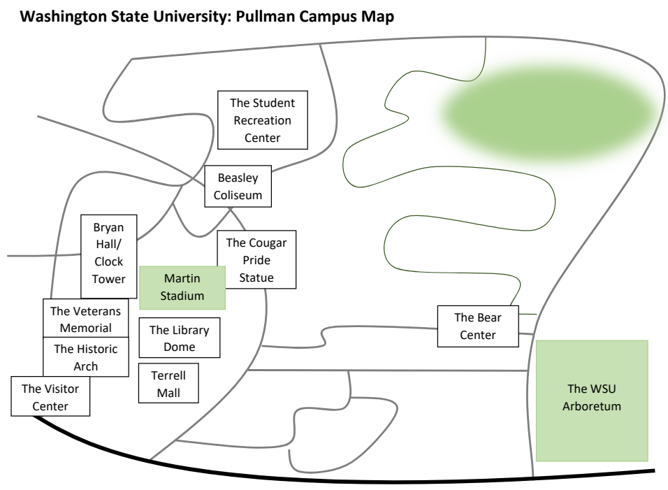
Main Experiment
Part 1
Part 2
Part 3
Either a specific or generic recognition is given (IV).
2-day
1-day

Slide 17
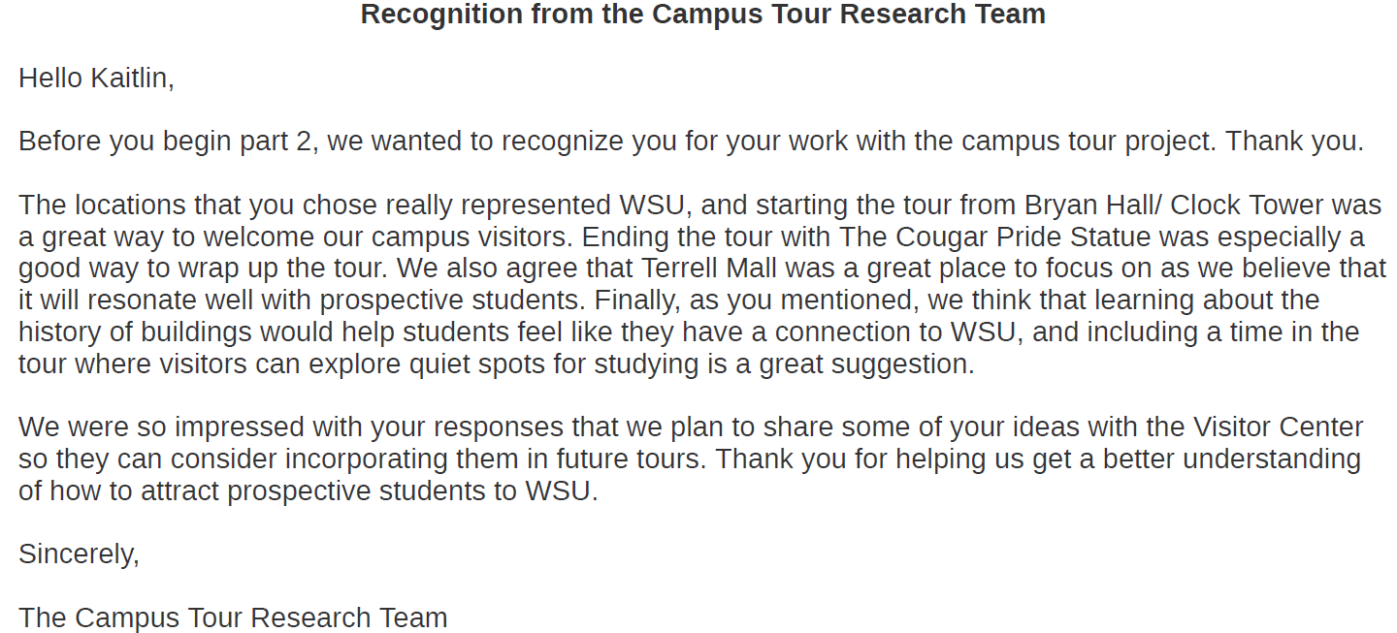
Main Experiment
{Name},

Slide 18
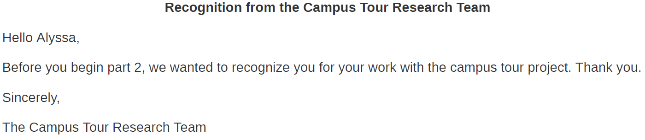
Main Experiment
{Name},

Slide 19

Main Experiment
Part 1
Part 2
Part 3
Either a specific or generic recognition is given (IV).
2-day
1-day
Measure Prosocial Motivation

Slide 20
Results
Specific recognition does not impact lower prosocially-motivated individuals
Higher prosocially-motivated individuals work harder after getting specific recognition

Slide 21



Results
Part 3
Performance

Slide 22
Follow-Up Experiment
Generic narrative
Work-specific praise
Specific work usefulness implications
Boilerplate narrative
Work-specific praise & Specific work usefulness implications

Slide 23
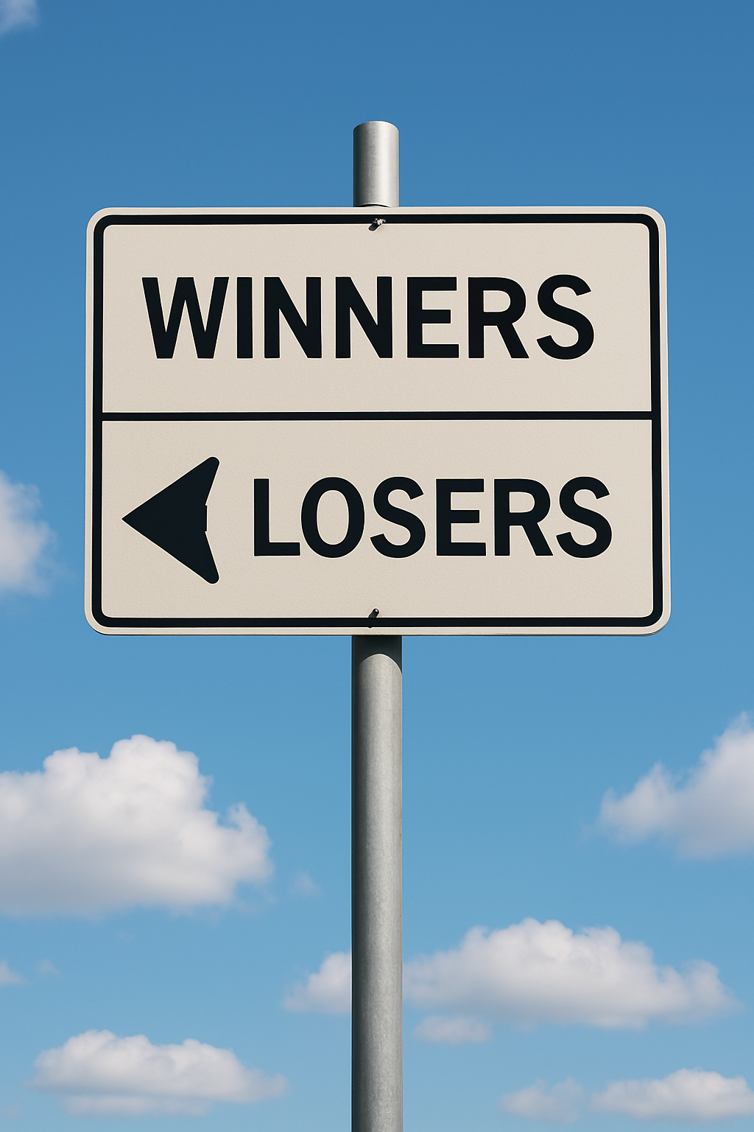
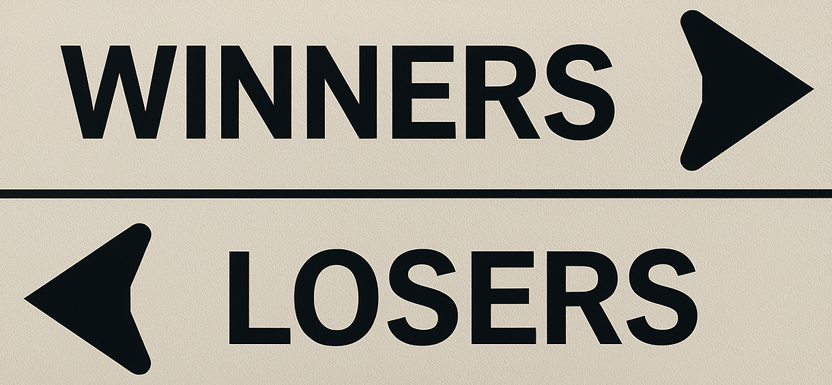
Follow-Up Experiment
Generic narrative
Work-specific praise
Specific work usefulness implications
Boilerplate narrative
Work-specific praise & Specific work usefulness implications

Slide 24
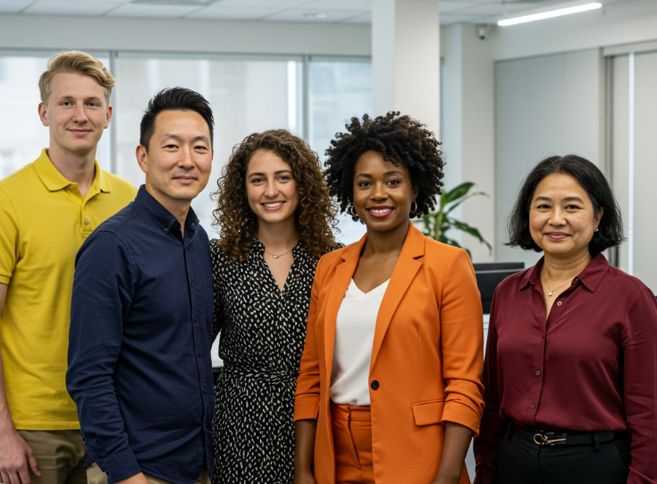
Implications for Practice
The specificity of what you say in recognition matters for high prosocial people
Know your people
  Is your company likely to attract high prosocial people?
  If you have mostly low prosocial people, consider awards or something else

Slide 25


Implications for Practice
How do I know if I have high prosocial people at my company?
  Industry?
  Culture?
  Consider a survey?

Slide 26
Poll Question
Do you use ChatGPT or another GenAI service to help you write recognition messages?
Never
Sometimes
Most of the time
Always

Slide 27
Questions?

Slide 28
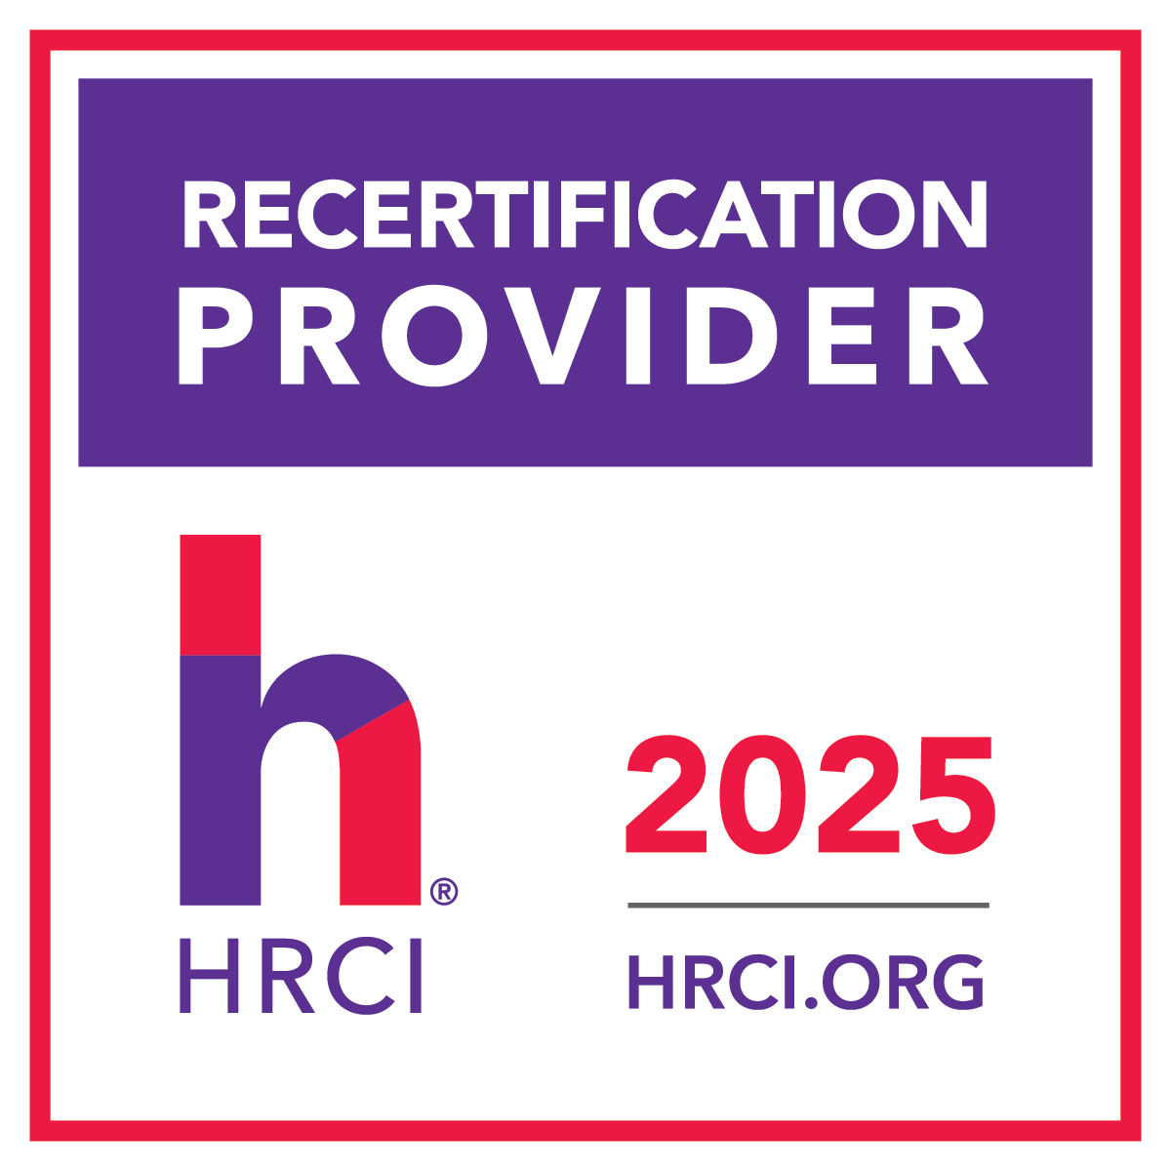
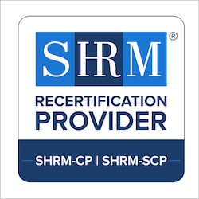
This program is pre-approved for
ONE HRCI Credit and
ONE SHRM PDC.
HR Certification Institute’s® (www.HRCI.org) official seal confirms that
Terryberry meets the criteria for pre-approved recertification credit(s)
for any of HRCI’s eight credentials, including SPHR® and PHR®.
This program has been approved for 1 (HR (General)) recertification credit hour
toward aPHR™, aPHRi™, PHR®, PHRca®, SPHR®, GPHR®, PHRi™ and SPHRi™
recertification through the HR Certification Institute.
Terryberry is recognized by SHRM to offer Professional Development Credits (PDCs) for SHRM-CP® or SHRM-SCP® recertification activities. This program is valid for 1 PDC for the SHRM-CP® or SHRM-SCP® .
25-XJYV9
698407

